Slide 1
Compiler Design and Construction
Sheikh Kashif Raffat
kashifraffat@fuuast.edu.pk

Slide 2
Grading
Assignments: 20%
Final: 60%
Final Report: 20%

Slide 3
What is a Compiler?
Source Language
L
Compiler
Target Language
L’
A compiler translates text from a source language, L, to a target language, L’.
A compiler is computer software that transforms computer code written in one programming language (the source language) into another computer language (the target language).
  C, C++, Ada, Java etc.

Slide 4
What is a Compiler?
Source Language
L
(sequence of characters)
Lexical Analyzer
(Scanner)
Sequence of Tokens
Syntax Analyzer
(Parser)
Abstract Syntax Tree
Symantic Analyzer
Abstract Syntax Tree
Intermediate Code
Generator
Intermediate Code
Optimized
Intermediate Code
Optimizer
Target Language
L’
Assembly Code
Machine Code
Code Generator

Slide 5
The Scanner
Reads characters from the source program.
Groups characters into lexemes
  sequences of characters that "go together"
Lexemes corresponds to a tokens; scanner returns next token (plus maybe some additional information) to the parser.
Scanner also discovers lexical errors (e.g., erroneous characters such as # in java).

Slide 6
Example Lexemes and Tokens
Lexeme:
;
=
index
tmp
21
64.32
Token:
SEMI-COLON
ASSIGN
IDENT
IDENT
INT-LIT
INT-FLOAT
Source Code:
position = initial + rate * 60 ;
Corresponding Tokens:
IDENT ASSIGN IDENT PLUS IDENT TIMES INT-LIT SEMI-COLON

Slide 7

The Parser
Groups tokens into "grammatical phrases", discovering the underlying structure of the source program.
Finds syntax errors.
Might find some "static semantic" errors,
e.g., a use of an undeclared variable, or variables that are multiply declared.
Might generate code, or build some intermediate representation of the program such as an abstract-syntax tree.

Slide 8
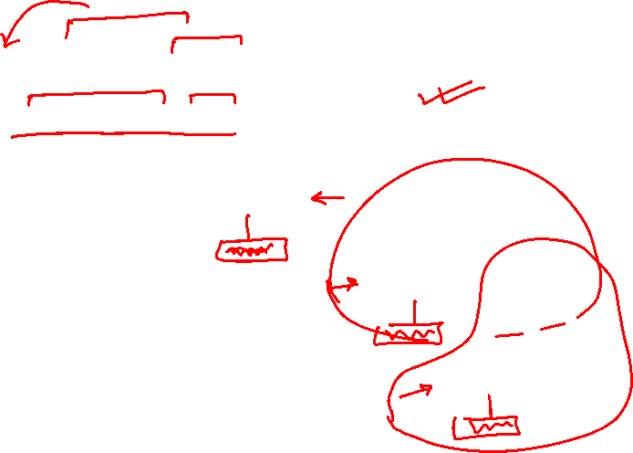
Example Parse
Source Code:
position = initial + rate * 60 ;
Abstract-Syntax Tree:
=
position
+
Interior nodes are operators.
A node's children are operands.
Each subtree forms "logical unit"
  e.g., the subtree with * at its root shows that
  because multiplication has higher precedence
  than addition, this operation must be performed
  as a unit (not initial+rate).
initial
*
rate
60

Slide 9
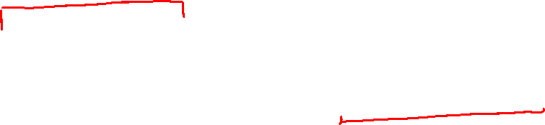
Semantic Analyzer
Checks for (more) "static semantic" errors
Annotate(interpret) and/or change the abstract syntax tree

Slide 10
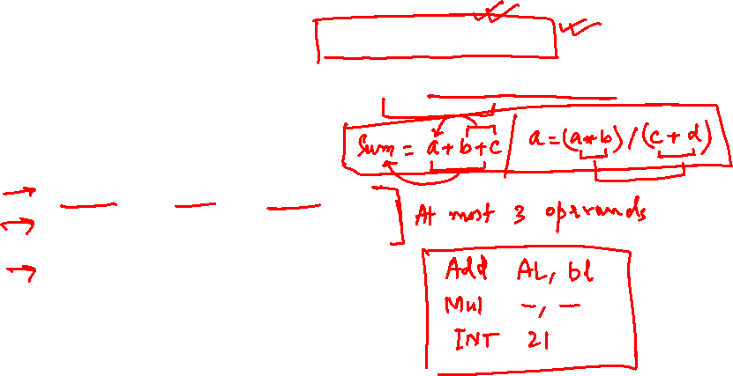
Intermediate Code Generator
Translates from abstract-syntax tree to intermediate code
One possibility is 3-address code
  each instruction involves at most 3 operands
  Example:
  temp1 = int(60)
  temp2 = rate * temp1
  temp3 = initial + temp2
  position = temp3

Slide 11
Optimizer
Tries to improve code to
  Run faster
  Be smaller
  Consume less energy

Slide 12
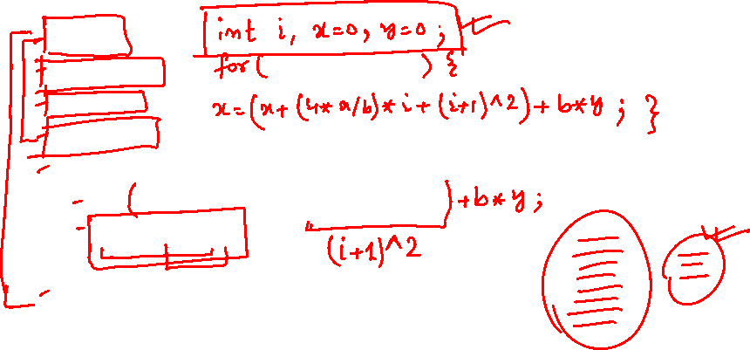
Try Optimizing This (for speed)
int sumcalc(int a, int b, int N)
{
int i;
int x, y;
x = 0;
y = 0;
for(i=0; i<=N; i++) {
x=x+(4*a/b)*i+(i+1)*(i+1);
x=x+b*y;
}
return x;
}

Slide 13
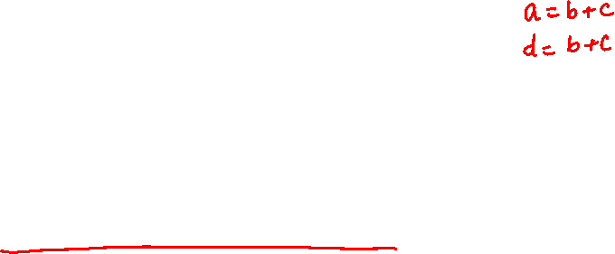
Some Types of Optimization
Constant Propagation
Algebraic Simplification
Copy Propagation
Common Sub-expression Elimination
Dead Code Elimination
Loop Invariant Removal
Strength Reduction

Slide 14
Code Generator
Generate object code from (optimized) intermediate code
Example:
.data
c1:
.float 60.0
.text
l.s $f0,rate
mul.s $f0,c1
l.s $f2,initial
add.s $f0,$f0,$f2
s.s $f0,position

Slide 15
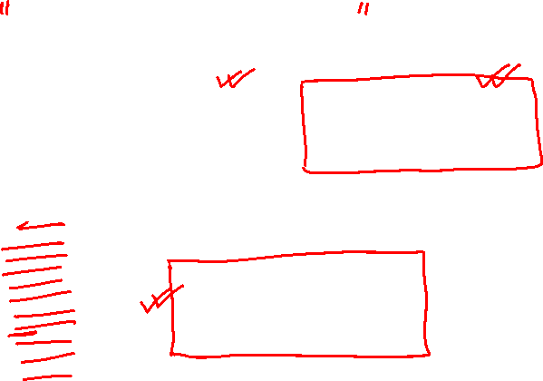
Symbol Tables
Lexical Analyzer
(Scanner)
Syntax Analyzer
(Parser)
Symantic Analyzer
Intermediate Code
Generator
Symbol Table
Optimizer
Code Generator

Slide 16

Symbol Tables
Keep track of names declared in the program
Separate level for each scope
Used to analyze static symantics:
  Variables should not be declared more than once in a scope
  Variables should not be used before being declared
  Parameter types for methods should match method declaration

Slide 17
Compiler Modularity
Lexical Analyzer
(Scanner)
Syntax Analyzer
(Parser)
Symantic Analyzer
Front End
Intermediate Code
Generator
Optimizer
Back End
Code Generator

Slide 18
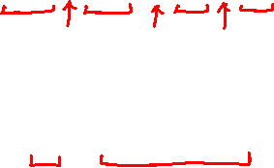
Translation of a Statement
result = initial + rate * 100
Lexical Analyzer
id1 = id2 + id3 * 100
Syntax Analyzer
=
id1 +
id2 *
id3 100

Slide 19
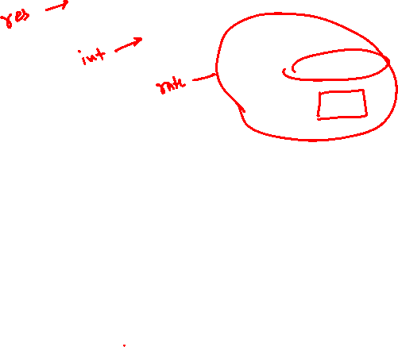
Semantic Analyzer
=
id1 +
id2 *
id3 inttoreal
100
Intermediate Code Generation
temp1 = inttoreal (100)
temp2 = id3 * temp1
temp3 = id2 + temp2
id1 = temp3

Slide 20
Code Optimizer
temp1 = id3 * 100.0
Id1 = id2 + temp1
Code Generator
Mov id3 , R2
Mul # 100.0 , R2
Mov id2 , R1
Add R2 , R1
Mov R1 , id1

Slide 21


Summary
Compilers Translate Source Language to Target Language
Compilers have several steps
  Scanner
  Parser
  Semantic Analyzer
  Intermediate Code Generator
  Optimizer
  Code Generator
Symbol Table Used To Keep Track of Names Used in Program
Front End and Back End Simplify Compiler Design
  Introduction of new languages
  Introduction of new hardware

